Slide 1
Project Presentation of FSE Project
On
Healthhub - Your Virtual Healthcare Assistant
Sai Krishna (2210992215)
Saksham (2210992218)
Samarpit Sharma(2210992235)
Sanskriti (2210992252)
Supervised By
Mr. Rahul
Department of Computer Science and Engineering,
Chitkara University, Punjab

Slide 2

Introduction
Welcome to HealthHub, a platform designed to transform the way you access healthcare. We connect patients with doctors seamlessly and provide AI-powered health guidance.
2

Slide 3



TECHNICAL DETAILS
Backend
MongoDB:
NoSQL database designed for handling large volumes of data.
Uses flexible, JSON-like documents to store data.
Supports dynamic schemas, allowing easy updates to data structure.
Provides horizontal scaling for managing distributed data.
Facilitates fast queries and indexing for efficient data retrieval.
Express:
Express is a minimal and flexible Node.js web application framework
that provides a robust set of features for web and mobile applications.
Express is a lightweight and flexible routing framework with minimal
core features meant to be augmented through the use of Express middleware modules.
Postman:
Postman is a global software company that offers an API platform for developers to design, build, test, and collaborate on APIs.

Slide 4
The Problem
Bottlenecks in Traditional Healthcare
Long Wait Times
Patients often face weeks or months of waiting for appointments.
Inconvenient Scheduling
Traditional scheduling methods are cumbersome and time-consuming.
Limited Access
Access to specialists can be geographically restricted.

Slide 5
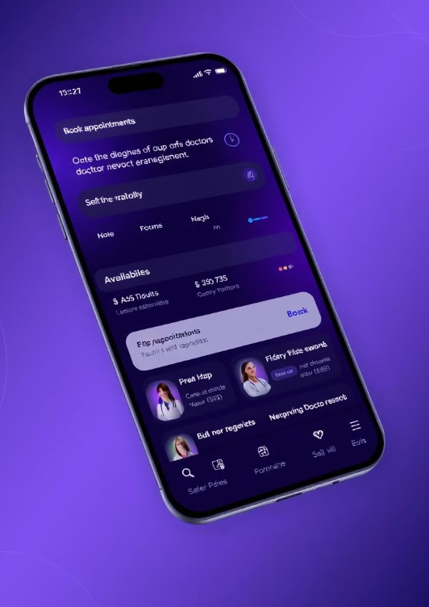
Our Solultion
Seamless Doctor Appointment Booking
Easy Online Scheduling
Book appointments with just a few clicks, anytime, anywhere.
Wide Network of Doctors
Access a diverse range of specialists in various fields.
Real-Time Availability
View doctors' schedules and choose the most convenient time for you.

Slide 6

Guidance
AI-Powered Health Guidance: Your Virtual Medical Assistant
24/7 Availability
Get instant answers to your health-related questions.
Personalized Insights
Receive tailored health advice based on your profile and concerns.

Slide 7
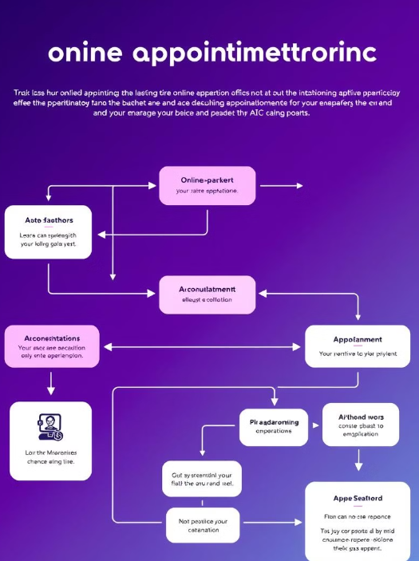
Working
How it Works: Simple Booking & AI Interaction
Create Account
Sign up and create your profile on [Website Name].
Book Appointment
Browse doctors and book a convenient meeting time.
AI Consultation
Access the AI assistant to discuss health concerns.

Slide 8
Tech Specs
Our platform is built on a modern technology stack to ensure security, scalability, and optimal performance.
Secure HTTPS: Ensures encrypted communication and data protection.
React & Tailwind CSS: Provides a responsive and intuitive user interface.
Node.js & MongoDB: Offers a scalable and efficient backend architecture.
AI powered via API integration: Delivers intelligent health guidance and personalized insights.

Slide 9

Elevating Healthcare Together
Thank you for joining us on this journey. We are making healthcare accessible to everyone.
HealthHub is not just a platform; it's a commitment to better health for all.
Empowering patients with seamless access to healthcare.
Driving efficiency and informed decision-making for doctors.
Pioneering AI-driven solutions for personalized health guidance.

Slide 10
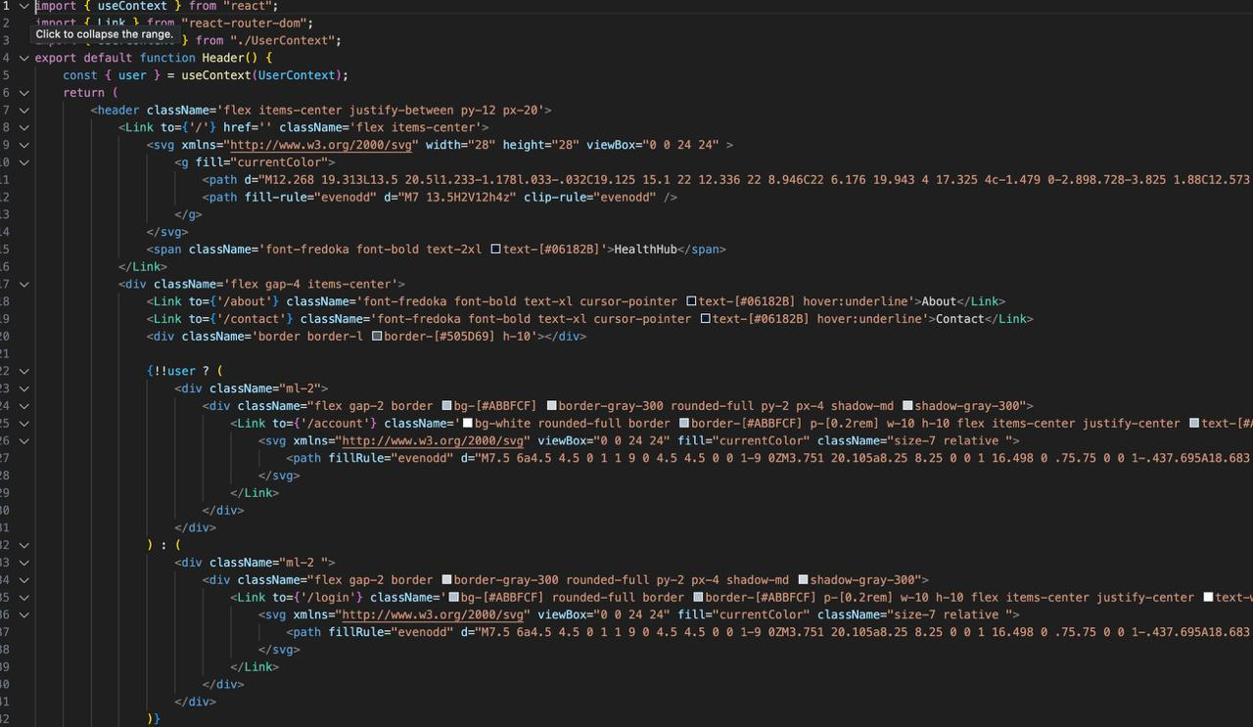
Code Snippets

Slide 11
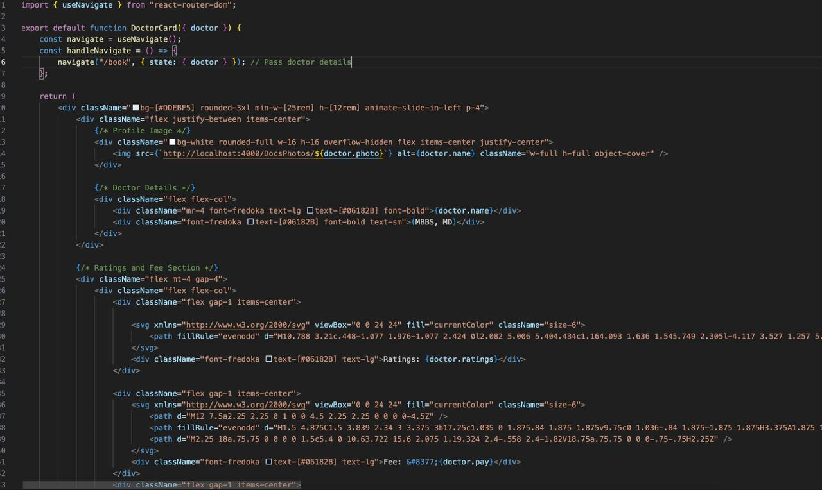
Code Snippets

Slide 12
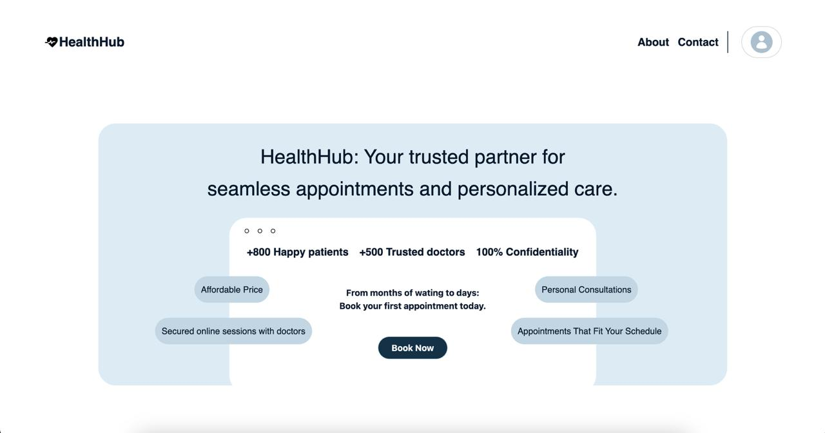
OUTPUT

Slide 13
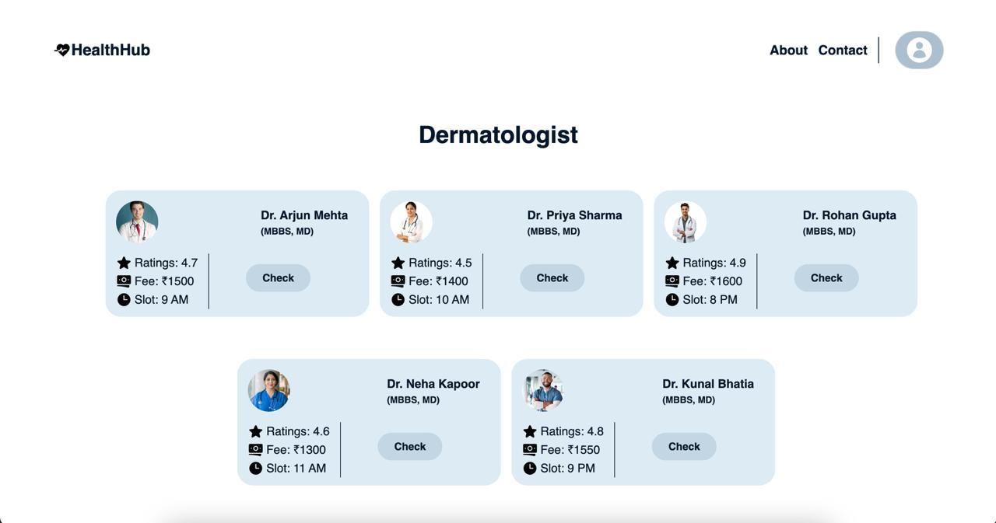
OUTPUT

Slide 14


